Slide 1



Identifying areas at risk for covid- 19 and other disasters
Emiko Sano
Minoo Taghavi
Cameron Vann
General Assembly, Washington- DC

Slide 2

Problem statement
1- Natural disasters can aggravate the impact of the COVID-19 pandemic.
2- Lack of tools for visualizing the combined risk.

Slide 3
Solution
Data Gathering/ Cleaning
1
Combine data by County
2
Identify CA counties with a combined risk (Clustering)
3
Map combined risks for easy identification.
4
Make recommendations.
5

Slide 4

WildfIRES
Wildfires Has Devastated California in 2020.
As of October 17th :
202 Total Fires.
19 Currently Active Fires.
32 People Killed.
3,549,923 Acres Burned (3% of all California)

Slide 5
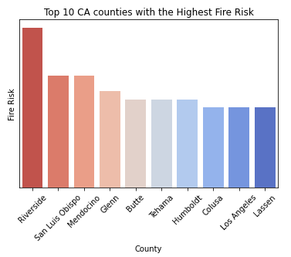
Fires has devastated Riverside county in 2020 !

Slide 6
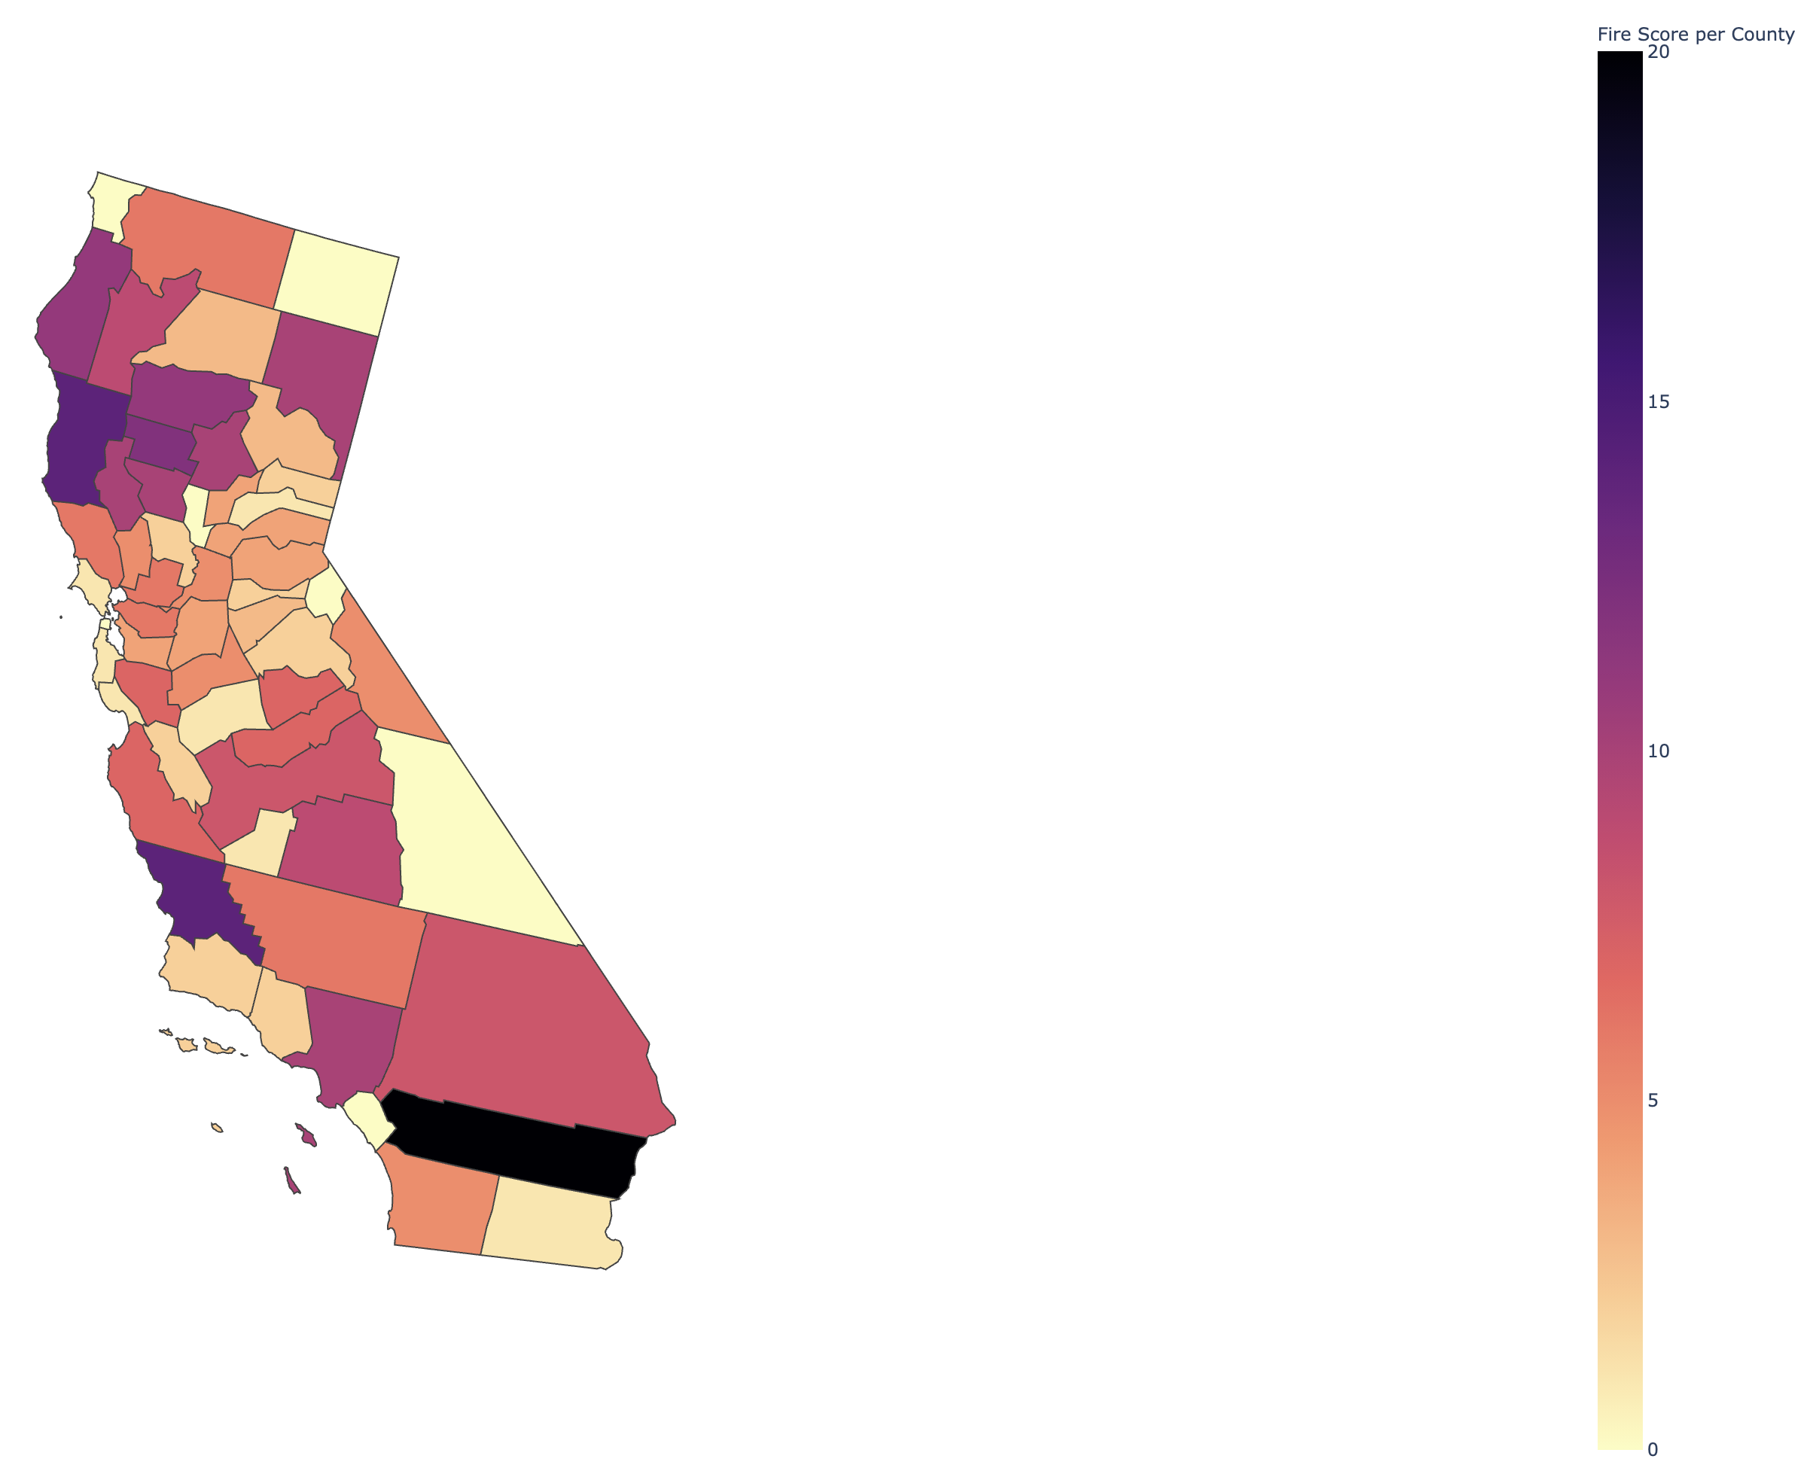
Fire Score per County in California

Slide 7


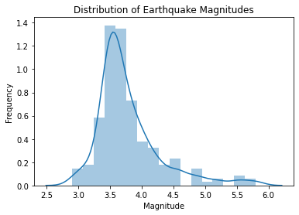
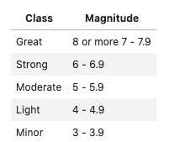
EARTHQUAKE
California Is Shaking A Lot …
But “Lightly”
200 Earthquakes Recorded as of October 17.

Slide 8
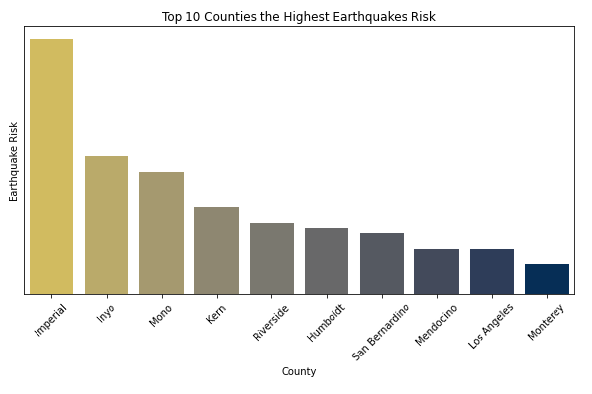
Earthquakes have been shaking mainly Imperial County in 2020.

Slide 9
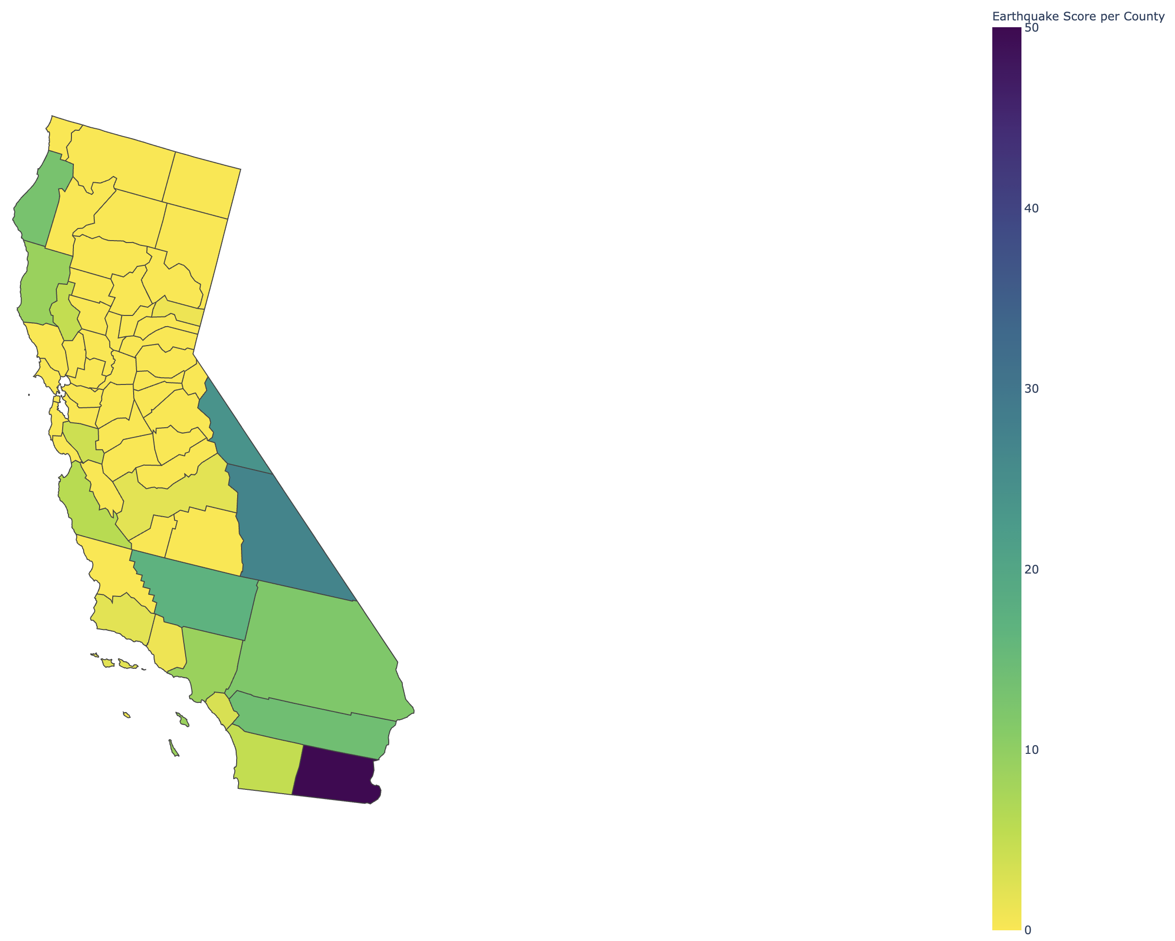
Earthquake Score
per County in California

Slide 10

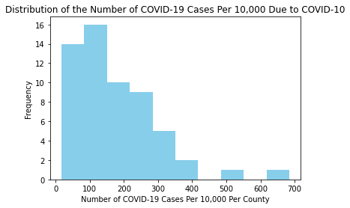
COVID-19
Is Affecting Some Counties More Than Others…
* 220 People per 10,000 have COVID-10 in CA.

Slide 11
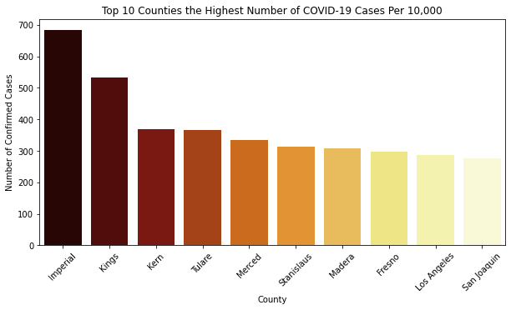
Covid-19 is sickening people in imperial county…

Slide 12
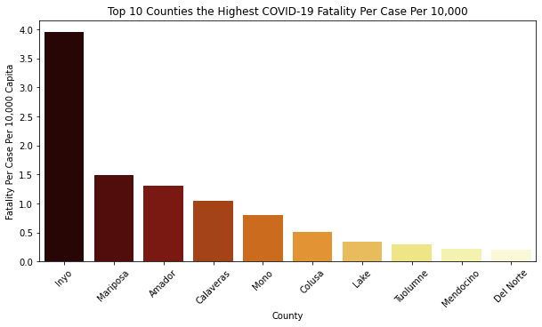
Is Inyo county lagging in effective Covid-19 treatments?

Slide 13
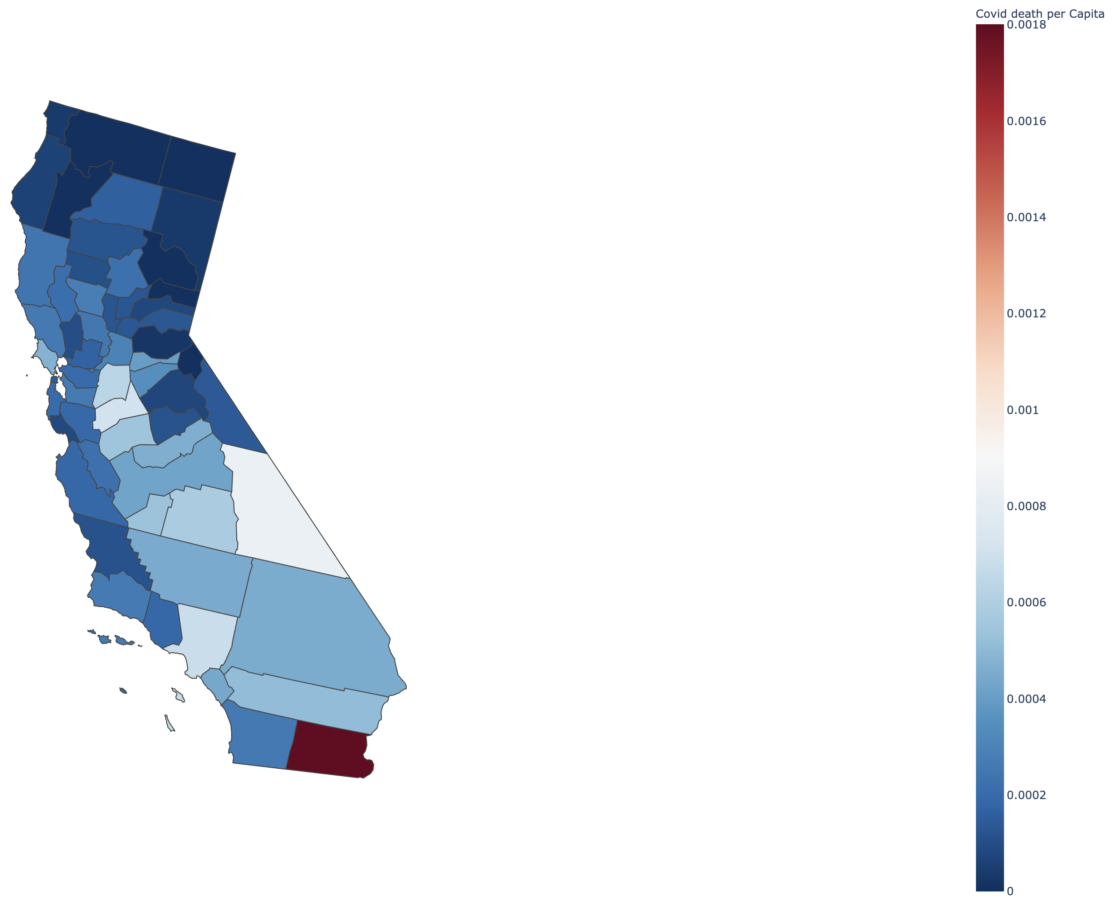
Covid Death per Capita
in California

Slide 14
MODELING FOR Combined RISK
Data
The Approach
Variable Engineering
Clustering Trial and Error
Algorithm Selection
PCA
Kmeans
PCA
KMeans
Clusters

Slide 15
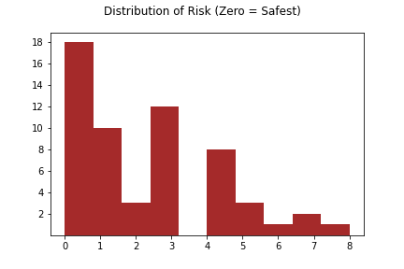
FINDING THE CLUSTERS
Principle Component
Analysis (PCA)
K-Means
Dimension Reduction
26
Variables
2
Variability Explained
62%
Risk Index

Slide 16
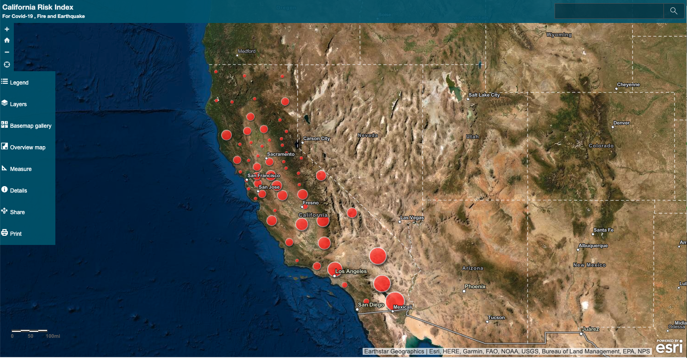
California Risk Index for Covid-19, Fire and Earthquake

Slide 17

Summary/ conclusion
We made a series of maps that can identify :
Fire risk alone
Earthquake risk alone
COVID-19 risk alone
Combined risk
We recommend that Imperial county considers a preparedness plan.

